Slide 1



Id Server
Facebook
5
Token
6
Authorization Code
ClientId + callback URL
2
Redirect to external IP login page
4
Login
3
Mobile browser
Uses AuthCode to retrieve identity and
refresh tokens
8
1
Navigate to https://IdServer.com/authorization/...
7
Mobile app retrieves auth code (polling)
Mobile App

Slide 2
Id Server
Use refresh token to retrieve
identity token and new refresh token.
1
Mobile App

Slide 3

Get the Json Web Key Tokens and check the identity token
Id Server
2
Profile service
3
Get a valid access token for the scope “scim_manage”
4
Use the access token to patch
the representation
Auth Server
SCIM2.0
Mobile App
1
Use the identity token to update the address

Slide 4
Get the Json Web Key Tokens and check the identity token
Id Server
2
Profile service
Retrieve a valid access token for the scope “scim_read”’
3
4
Use the access token to get
the representation
Auth Server
SCIM2.0
Use identity token to get the latest representation
Mobile App
1
5
Representation is returned

Slide 5

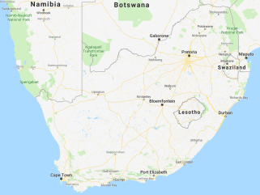



Auth Server
2
Get valid access token for the scopes “scim_read”, “barcode_read”, “testresult_read”
SCIM2.0
BarCode API
Test Result API
Use the access token
to search the bar codes
4
Use the access token to search the representations based on location / gender / ethnicity etc…
Use the access token to search the test results
3
5
Reporting API
VL > 30000
Search the results
Results returned
20000 < VL > 30000
1
6
10000 < VL > 20000
Reporting Website
VL > 10000

Slide 6












InMemory caching
Postgres repo
Sqlite repo
Redis caching
SqlServer repo
InMemory repo
OAuthRepository
OpenIdEvtHandler
SqlServer sink
ES sink
File sink
OAuthStore
RabbitMq
Bus
InMemory
Logging
OpenId Host

Slide 7
InMemory caching
Postgres repo
Sqlite repo
Redis caching
SqlServer repo
InMemory repo
Caching
SCIM Repository
ScimEvtHandler
RabbitMq
Bus
InMemory
SCIM Host

Slide 8
InMemory caching
Postgres repo
Sqlite repo
Redis caching
SqlServer repo
InMemory repo
SqlServer sink
Caching
OAuthRepository
OAuthStore
File sink
UMARepository
UmaEvtHandler
UMATicketStore
ES sink
RabbitMq
Bus
InMemory
Logging
UMA Host

Slide 9



Postgres repo
Sqlite repo
SqlServer repo
InMemory repo
EventStore repository
EventStore Host

Slide 10
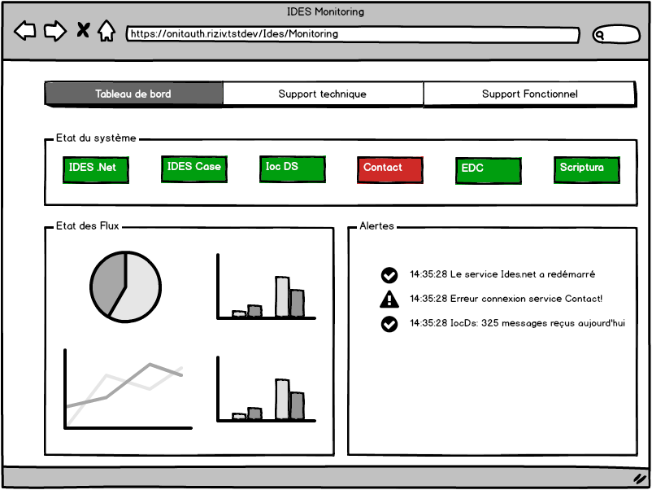
CASE 360
DB Servers
Consolidation DB
1
vwAtpMilestones
Atp
Support website
App Fabric
2
ValidateAtp
DossierWriter
Service
3
WriteAtp

